Slide 1

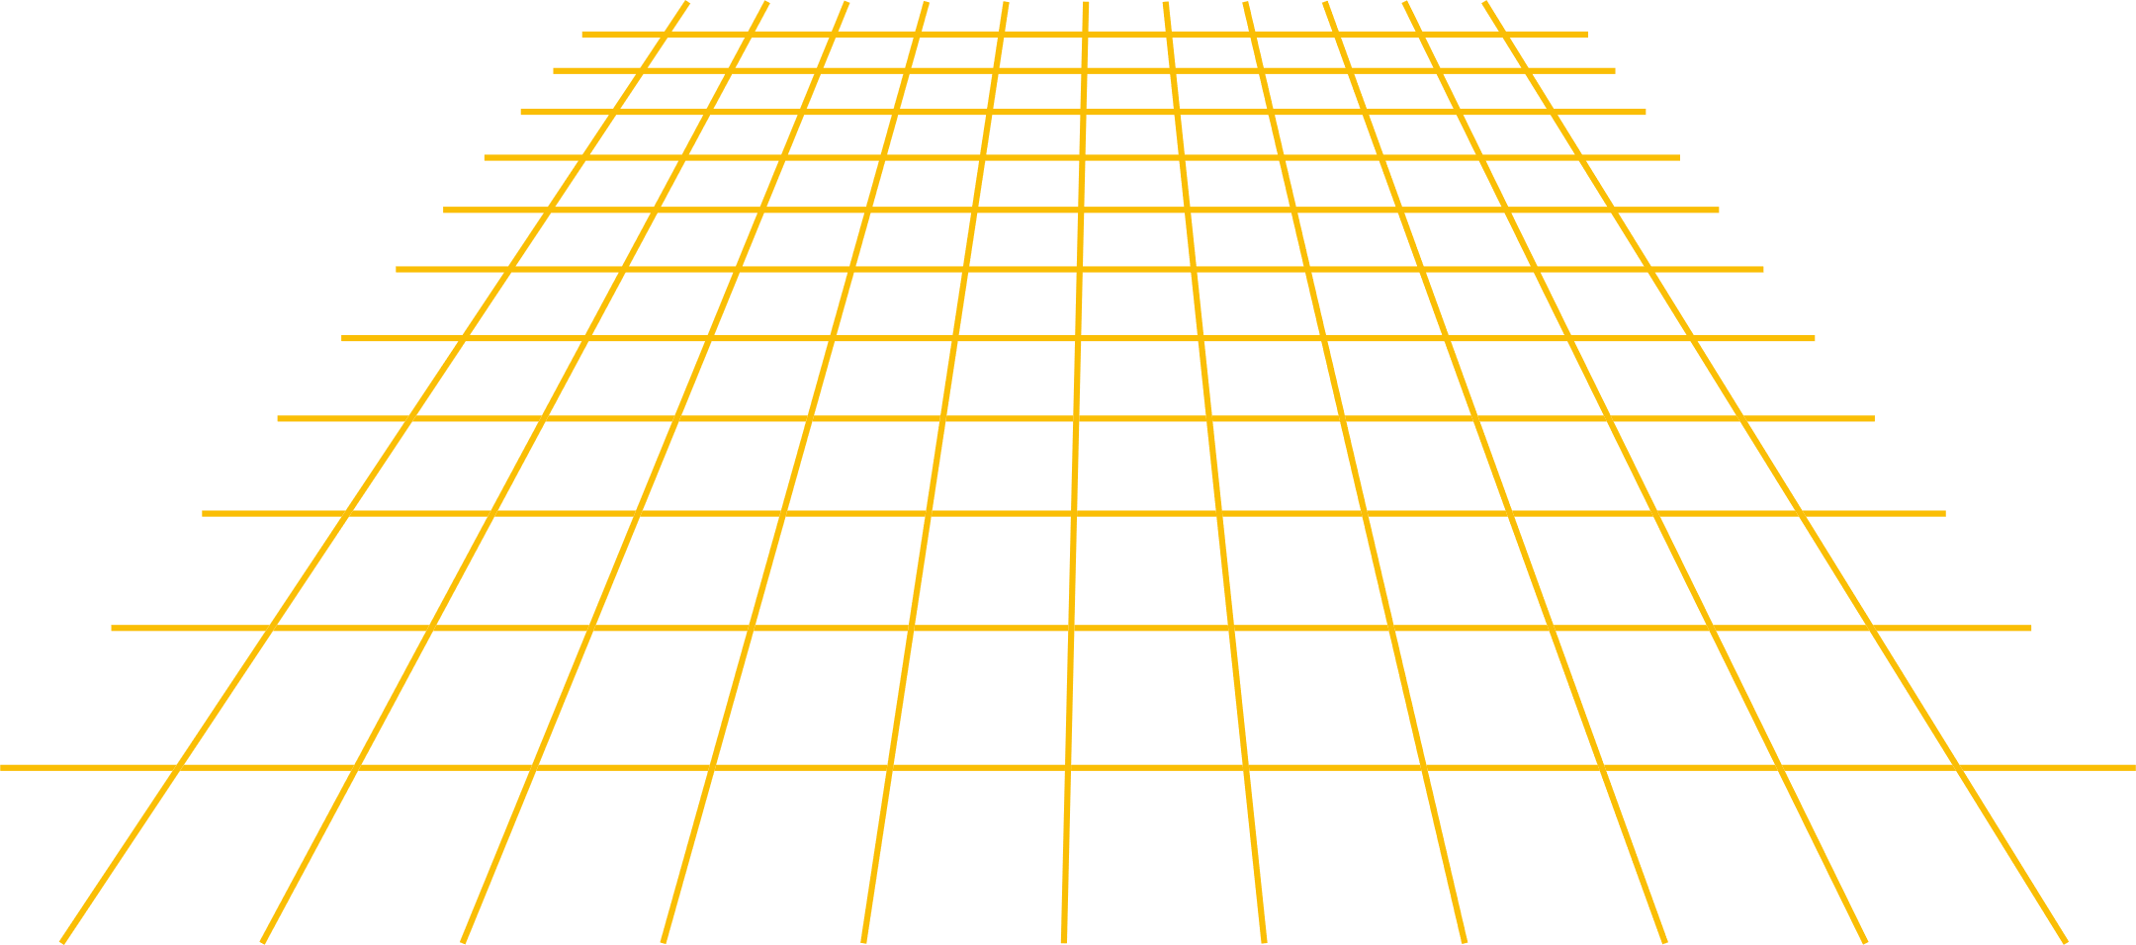
Mahmoud Mourad
Home
Data Overview
Type
Location
Delivery
Real State
Analysis:
Available From .
2023 to 2027

Slide 2

Data Overview
About us
Location
Mahmoud Mourad
Home
Type
Delivery
Agenda
01
04
Insights and Analyses
Intro
02
05
Data Overview
Summary
03
problems
06
thank you

Slide 3

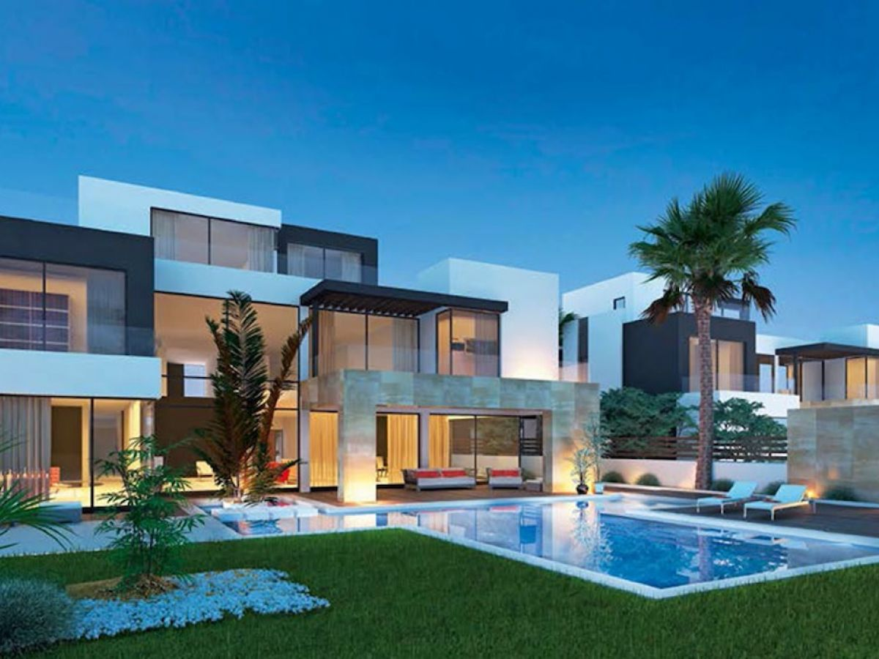
Mahmoud Mourad
Home
Data Overview
Type
Location
Delivery
Intro & Overview
This dataset contains 20,000 real estate property listings collected from Property Finder Egypt.
It includes detailed information about properties for sale such as price, size, location, type, number of bedrooms/bathrooms, availability, and payment methods.

Slide 4


Mahmoud Mourad
Home
Data Overview
Type
Location
Delivery
Problems
The Location column contains promotional text, not real geographic addresses.
Because the text isn’t an actual location, geocoding tools
(like Geolocator) cannot detect cities or coordinates, so all geolocation attempts fail.

Slide 5
Average Price per sqm
Average Price per sqm
Average Price per sqm
Data Overview
About us
Location
Mahmoud Mourad
Home
Type
Delivery
KPIs
18.3K
220
Total Units
Average Size
16.5M
60
Average Price
Number of cities
76.2K
1.4K
Average price per sqm
Number of compounds

Slide 6
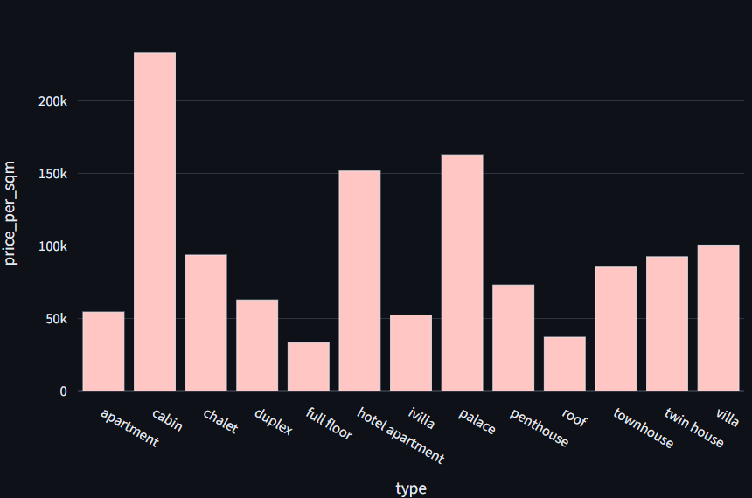

Mahmoud Mourad
Home
Data Overview
Type
Location
Average price per type
cabins commanding the highest average price per square meter, exceeding 200k. In contrast, the full floor type registers the lowest value, at under 30k. Property types like palaces and hotel apartments also fall into the high-valuation tier.

Slide 7
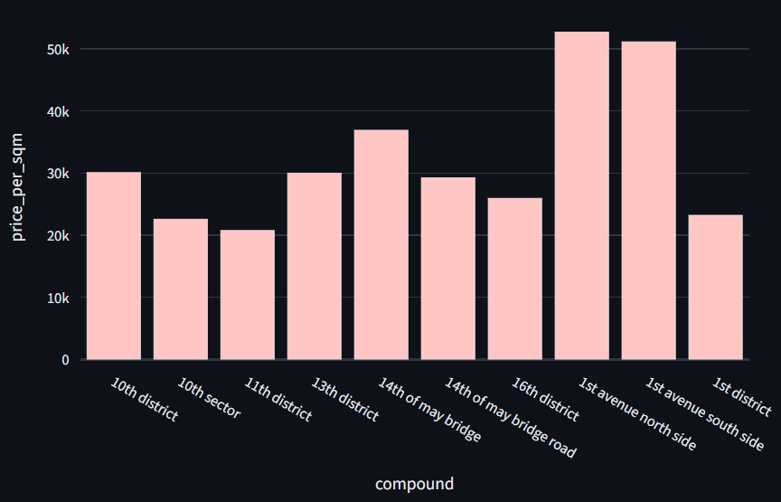
Mahmoud Mourad
Home
Data Overview
Type
Location
Average price per compound (Top 10)
This chart ranks the top ten compounds by average price per square meter. The most expensive areas are the 17th avenue south side and the 1st avenue north side, both priced above 50k. A significant price gap exists within this top list, as the lowest-ranked compounds (such as the 10th and 11th districts) hover around the 20k to 25k range.

Slide 8
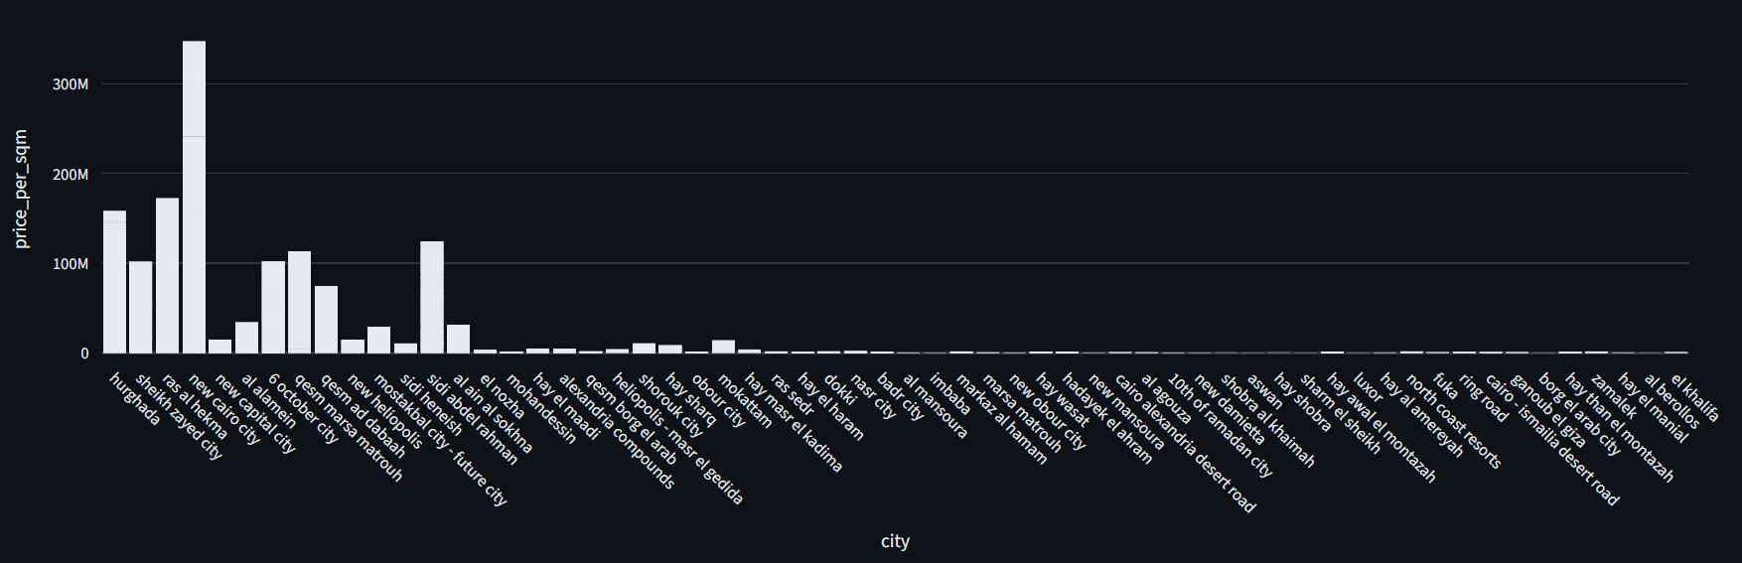


This bar chart shows the average price per square meter, with New Cairo City reaching the highest peak, significantly outpricing all other locations at nearly 350 million. Most other cities listed have substantially lower property values, demonstrating a large price variance across the market.

Slide 9
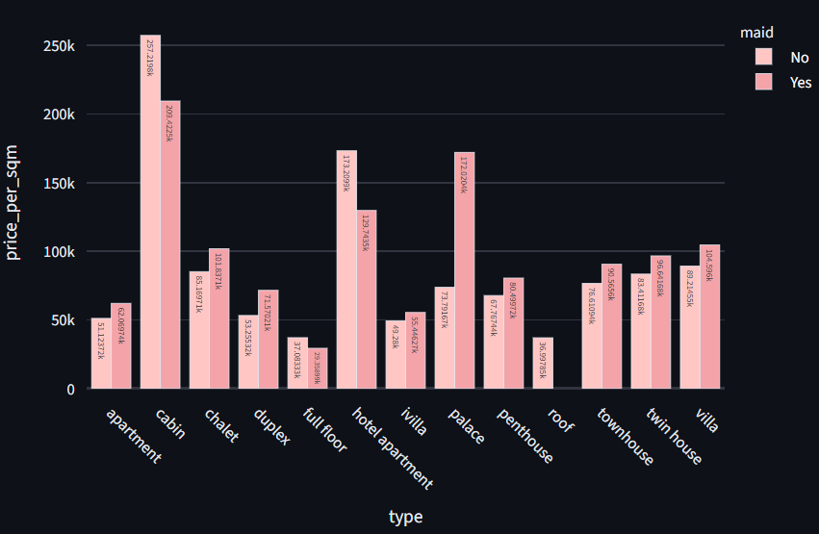
Mahmoud Mourad
Home
Data Overview
Type
Location
Delivery
Average Price per sqm by Unit Type and Maid Availability
This grouped bar chart compares the average price per square meter across different property types, distinguishing between those with and without a maid's room. Cabins that include a maid's room command the highest price per square meter, peaking at approximately 257,000. For nearly all property categories shown, the presence of a maid's room correlates directly with a noticeable increase in the average selling price.

Slide 10
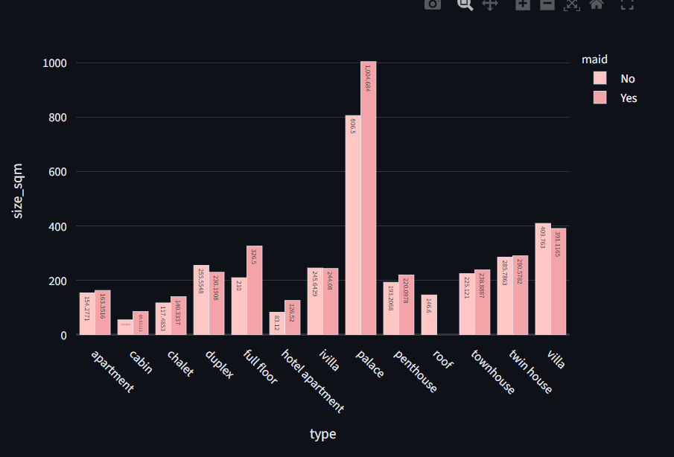
Mahmoud Mourad
Home
Data Overview
Type
Location
Delivery
Average Price per sqm by Unit Type and Maid Availability
These charts compare the average property size (sqm) and the price per square meter (k) across various types, distinguished by the inclusion of a maid's room. The Palace type holds the largest average size (over 1,000 sqm), while the structurally smaller Cabin commands the highest price per square meter (over 257k). Crucially, the presence of a maid's room correlates with both a larger average size and a higher average price per square meter in nearly all property categories.

Slide 11
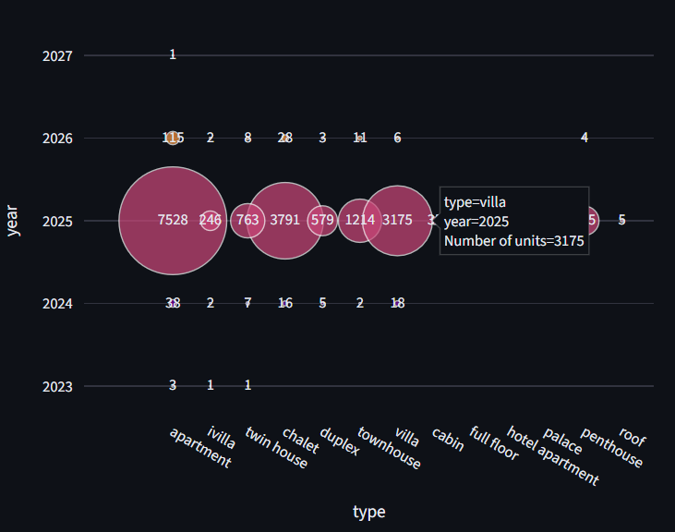
Mahmoud Mourad
Home
Data Overview
Type
Location
Delivery
Delivery Units Supply Trend per Year
These charts compare the average property size (sqm) and the price per square meter (k) across various types, distinguished by the inclusion of a maid's room. The Palace type holds the largest average size (over 1,000 sqm), while the structurally smaller Cabin commands the highest price per square meter (over 257k). Crucially, the presence of a maid's room correlates with both a larger average size and a higher average price per square meter in nearly all property categories.

Slide 12
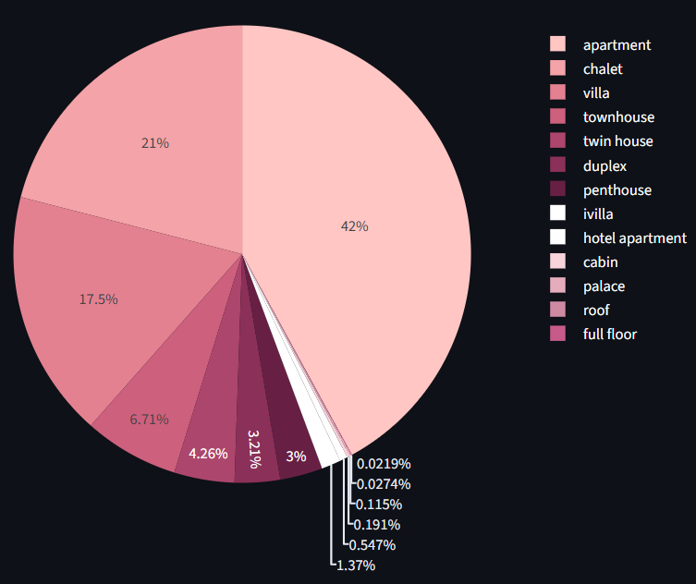
Mahmoud Mourad
Home
Data Overview
Type
Location
Delivery
Unit Type Distribution
Apartments (42%) and Villas (21%) dominate the market distribution, but property metrics vary significantly across types. While the Palace type has the largest average size (over 1,000 sqm), the smaller Cabin commands the highest price per square meter (over 257k). In nearly all property categories, the presence of a maid's room correlates with both a larger average size and a higher price per square meter.

Slide 13
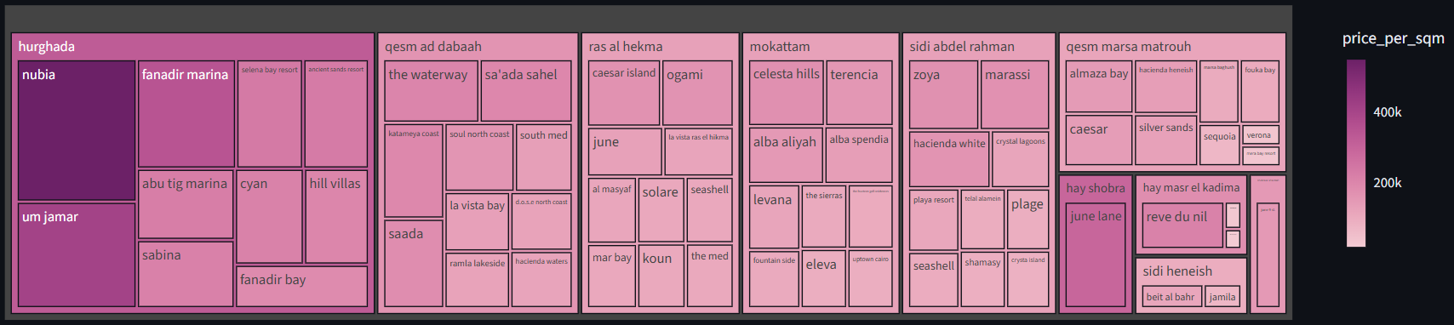
Mahmoud Mourad
Home
Data Overview
Type
Location
Delivery
Top 10 Compounds Within Top 10 Cities (By Avg Price per SQM)
While Apartments and Villas hold the largest market share, the average price per square meter is highly variable across geographical locations and compounds, with some areas approaching 400k. The market shows a decoupling of size and price, as the Palace is the largest property type, but the smaller Cabin commands the highest price per square meter (over 257k). For almost all property categories, the inclusion of a maid's room consistently correlates with both a larger average size and a higher price per square meter.

Slide 14
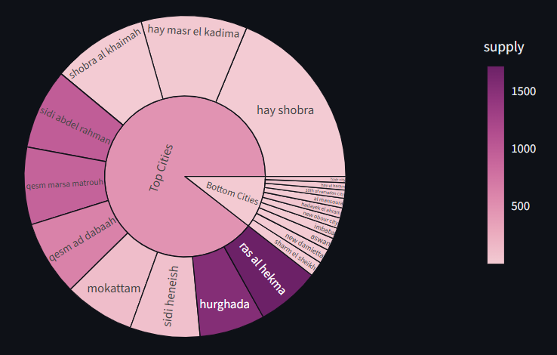
Mahmoud Mourad
Home
Data Overview
Type
Location
Delivery
Top 10 Compounds Within Top 10 Cities
Apartments dominate the market share, yet geographical areas like Hurghada and Ras Al Hekma show the highest supply volume and volatile prices, which can exceed 400k per square meter. The market exhibits a clear decoupling of size and cost: the largest property, the Palace, is significantly outsold in per-square-meter price by the much smaller Cabin, with the inclusion of a maid's room acting as a premium factor for both size and cost.

Slide 15
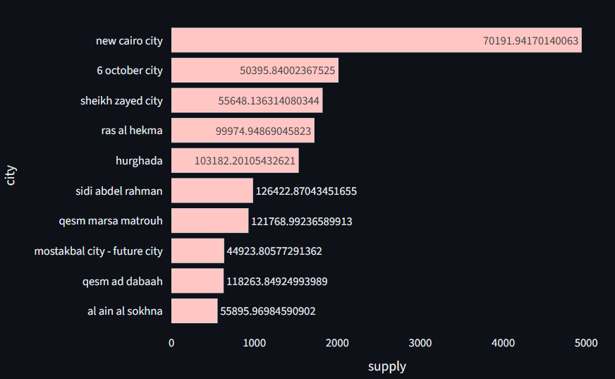
Mahmoud Mourad
Home
Data Overview
Type
Location
Delivery
Top Cities by Average price per sqm and supply
New Cairo City leads in overall property supply, with Apartments dominating market frequency, while prices are highly volatile, reaching over 400k per square meter in specialized geographic areas like Hurghada. The market shows a decoupling of size and cost, where the smaller Cabin commands the highest price per square meter (257k), and the presence of a maid's room consistently drives up both the average size and the price across all property types.

Slide 16
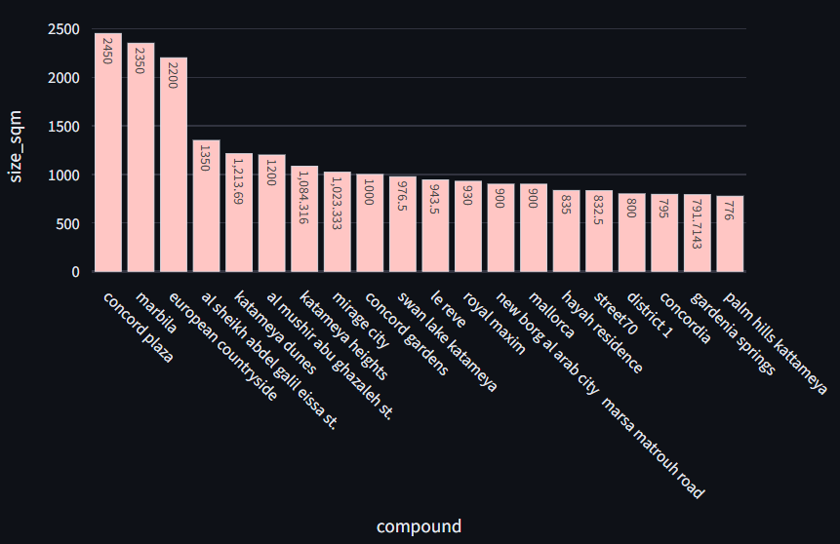
Mahmoud Mourad
Home
Data Overview
Type
Location
Delivery
The 20 largest compound by Average size sqm

Slide 17
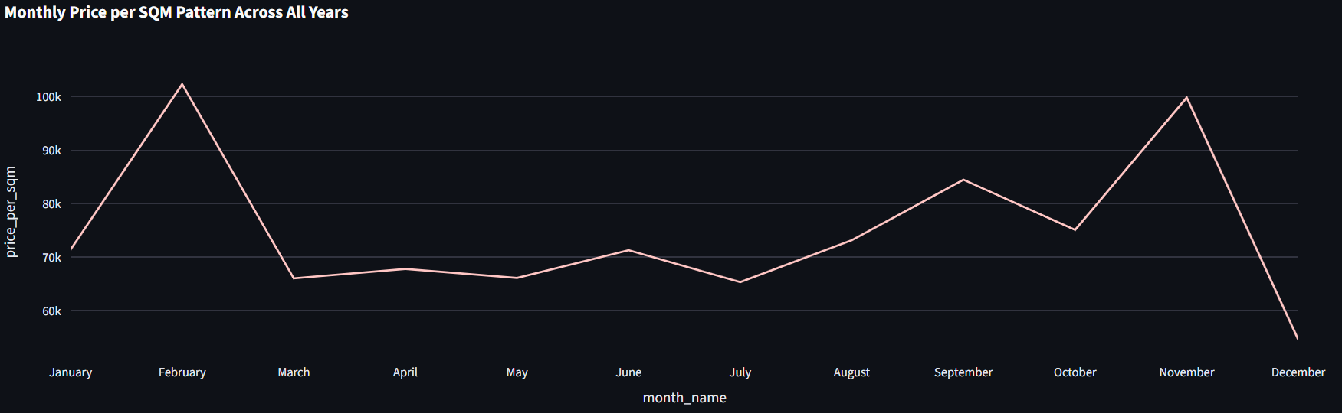
Mahmoud Mourad
Home
Data Overview
Type
Location
Delivery
The property market exhibits high seasonality, with prices peaking in February and November (over 100k), and is dominated by Apartments in frequency and New Cairo City in overall supply, yet geographical prices are volatile, reaching over 400k; the smallest property type, the Cabin, commands the highest price per square meter (257k), while the largest sizes are found in compounds like Marbila (2,450 sqm), all consistently demonstrating that the inclusion of a maid's room is a premium feature.

Slide 18
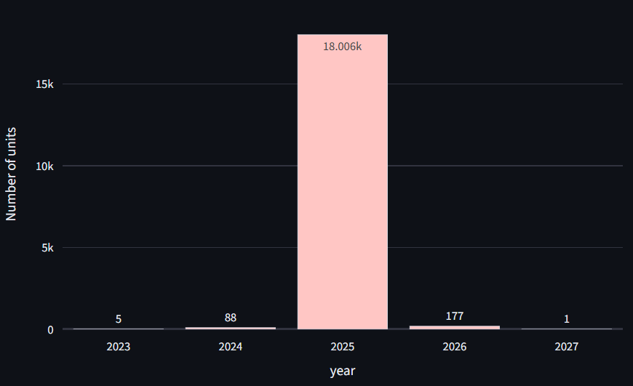
Mahmoud Mourad
Home
Data Overview
Type
Location
Delivery
Delivery Units Supply Trend per Year

Slide 19
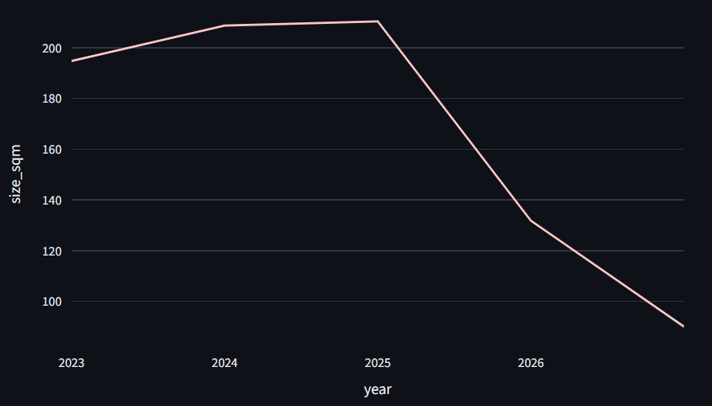
Mahmoud Mourad
Home
Data Overview
Type
Location
Delivery
Average Unit Size by Delivery Year

Slide 20
Data Overview
About us
Location
Mahmoud Mourad
Home
Type
Delivery
Summary
Summary of Property Market Characteristics
Type:
"Apartments" and "Villas" dominate the market supply frequency (42% and 21% respectively), but "Cabins" command the highest price per square meter (257k), while "Palaces" are the largest in size.
The presence of a maid's room acts as an additional factor for consistently increasing both the average size and price for all types.
Location:
"New Cairo City" leads the list of cities in total supply (over 70,000 units), although other areas show high volumes, such as Hurghada and Ras Al Hekma.
The market shows immense geographical price volatility, with prices exceeding 400k per square meter in certain specified compounds like "Nubia" in Hurghada.
Delivery/Time:
The price per square meter exhibits a clear seasonal pattern, reaching its peak in February and November.
The largest portion of units expected to be delivered is concentrated in the year 2025, and a sharp decrease in the average unit size is expected after this year.

Slide 21



Mahmoud Mourad
Home
Data Overview
Type
Location
Delivery
Thank
You
"Thank you for your time and attention—looking forward to future success together!"

